Slide 1




Building Conversational Agent
Presented BY
Debaditya Mandal ( Research Analyst in NLP)
d94mandal@gmail.com
https://www.linkedin.com/in/debaditya-mandal

Slide 2
What is Intelligence ?
Intelligence may be defined as:
The capacity to acquire and apply knowledge.
The faculty of thought and reason.

Slide 3
What is Artificial Intelligence ?
Artificial intelligence is the study of systems that act in a way that to any observer would appear to be intelligent.
Artificial Intelligence involves using methods based on the intelligent behavior of humans and other animals to solve complex problems.
AI is concerned with real-world problems (difficult tasks), which require complex and sophisticated reasoning processes and knowledge.

Slide 4
What is Artificial Intelligence?
Some Definitions
Weak AI: AI develops useful, powerful applications.
Strong AI: claims machines have cognitive minds comparable to humans.

Slide 5
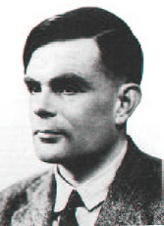
Turing Test
In 1950 Turing proposed an operational definition of intelligence by using a Test composed of :
An interrogator (a person who will ask questions)
a computer (intelligent machine !!)
A person who will answer to questions
A curtain (separator)
A. Turing

Slide 6
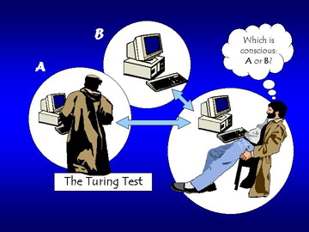
Continued
The computer passes the “test of intelligence” if a human, after posing some written questions, cannot tell whether the responses were from a person or not.

Slide 7
Components of AI
To give an answer, the computer would need to possess some capabilities:
Natural language processing: To communicate successfully.
Knowledge representation: To store what it knows or hears.
Automated reasoning: to answer questions and draw conclusions using stored information.
Machine learning: To adapt to new circumstances and to detect and extrapolate patterns.
Computer vision: To perceive objects.
Robotics to manipulate objects and move.

Slide 8
Goals of AI
AI began as an attempt to understand the nature of
intelligence, but it has grown into a scientific and
technological field affecting many aspects of commerce
and society. The main goals of AI are:
Engineering: solve real-world problems using knowledge and reasoning. AI can help us solve difficult, real-world problems, creating new opportunities in business, engineering, and many other application areas.
Scientific: use computers as a platform for studying intelligence itself. Scientists design theories hypothesizing aspects of intelligence then they can implement these theories on a computer.

Slide 9
Natural Language Processing(NLP)
&
Natural Language Understanding(NLU)

Slide 10
What is Natural Language Processing(NLP)
Natural language processing (NLP) is a subfield of linguistics, computer science, information engineering, and AI concerned with the interactions between computers and human (natural) languages, in particular how to program computers to process and analyze large amounts of natural language data. Challenges in natural language processing frequently involve speech recognition, natural language generation, natural language understanding.

Slide 11
Levels of NLP
Speech
Text
Phonetic/Phonological Analysis
OCR/Tokenization
Morphological Analysis
Syntactic Analysis
Semantic Interpretation
Discourse Processing

Slide 12
What is Information Extraction
Information extraction (IE) is the task of automatically extracting structured information from unstructured and/or semi-structured machine-readable documents.Typical IE tasks and subtasks include:
Template filling
a. Event extraction
Knowledge Base
a. Named entity recognition
b. Coreference
c. Relationship extraction
Table extraction
Table information extraction
Comments extraction
Terminology extraction
Audio extraction

Slide 13
Information Extraction
Unstructured Text
“Barack Obama was born in Hawaii”
Information Extraction
Structured Information
was
was born in
Born
Barack Obama
Hawaii

Slide 14



Sentiment Analysis
Attributes:
Battery
Ease of Use
Price
Camera Quality
Battery is good
It is very easy to operate the phone
Price is affordable
Camera quality is very bad

Slide 15
Machine Translation
Source Text (Bengali)
Automatic Translation
Helping people to understand meaning of different language without knowing the syntax of that language
Machine Translation performs simple substitution of words in one language for words in another
আমি কাজ করছি
Destination Text (English)
I am working

Slide 16
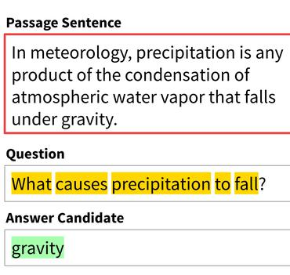






Language Technology
Mostly solved
Good Progress
Not Solved
Sentiment Analysis
Question and Answering
Spam Detection
This movie is good
You are shortlisted
This is worst product
Deals you can't refuse | Great Indian Festival
Coreference Resolution
POS Tagging
Raghu was listening his favourite song
Pappu is working
Machine Translation
NNP VBZ VBG
আমি কাজ করছি
Named Entity Recognition
I am working
Text Summarization
Word sense disambiguation
Einstein met with Tagore at Berlin
This mouse is very fast
Person Person Loc
Information Extraction
I am in Chennai
Chennai
Text Parsing
Conversation
I am in Chennai

Slide 17
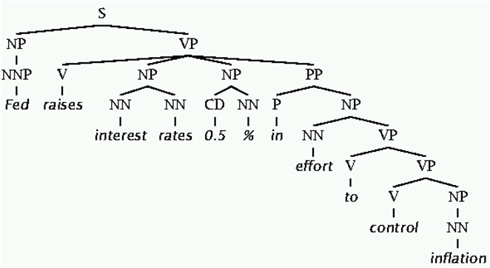
Why is NLU difficult
The hidden structure of the language is ambiguous.
e.g:- Fed raises interest rates 0.5% in effort to control inflation (NYT headline 5/17/00)

Slide 18
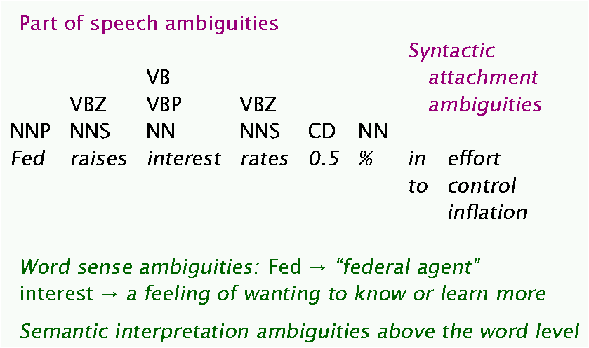
Cause of Ambiguity

Slide 19
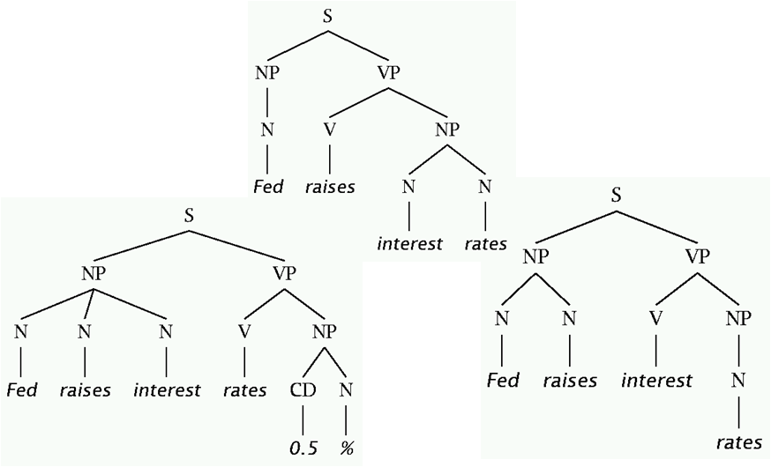
Verb and Noun Ambiguities

Slide 20
Parsing
We will apply grammar rule to find possible structure of a sentence
We can do this either by bottom-up approach or by top-down approach

Slide 21
Context Free Grammar(CFG)
G = (T, N, S, R)
T is set of terminals
N is set of Non-terminals
S is the start symbol
R is rules/productions of the form , where X is a nonterminal and g is a sequence of terminals and nonterminals (possibly an empty sequence)
A grammar G generates a language L

Slide 22
Example of CFG
S->NP VP
NP->DT N
DT->The
N->teacher
VP->V NP
V->praised
NP->DT N
DT->the
N->student
S
NP
VP
DT
N
N
NP
The
teacher
N
praised
DT
the
student

Slide 23
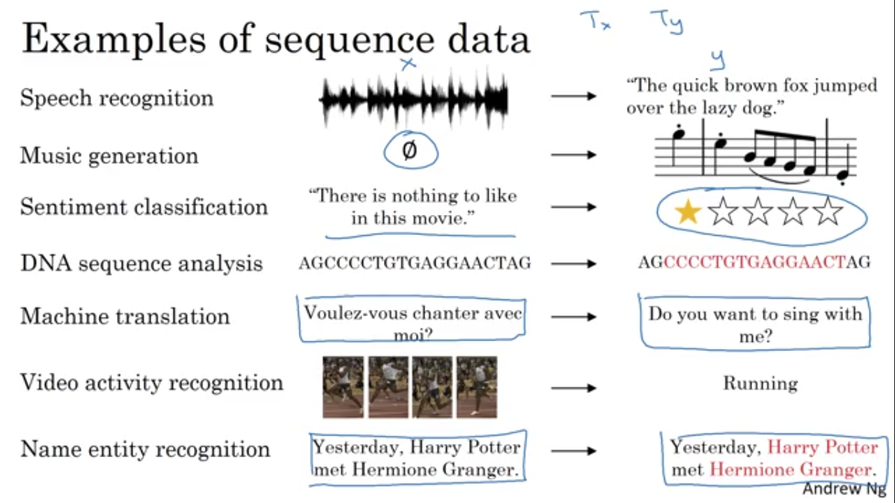
Sequence to Sequence model

Slide 24
Types of sequence-to-sequence model
Many-to-Many
- input length == output length
e.g:- Speech Recognition
- input length != output length
e.g:- conversation
Many-to-One
e.g:- Sentiment Analysis
One-to-Many
e.g:- Music Generation

Slide 25
Bidirectional RNN/LSTM is required to understand the proper meaning.
e.g:-
He said,”Teddy Roosevelt was a great president”
He said,”Teddy bears are on sale”
From these examples it will be very difficult to extract “Teddy” as person name without knowing the meaning of later words of this word.To solve this issue we need bidirectional network.

Slide 26
Vector representation of word
One Hot Encoding
Word Embedding
- Word2Vec

Slide 27
Thank you

